Slide 1

A WORLD VIEW of OPIOID USE DISORDER BEST PRACTICES
with COMPARISON to the UNITED STATES:
NELSON MULLINS – “Health TechNet”
Edwin C. Chapman, MD, DABIM, FASAM
Adjunct Assistant Professor Department of Behavioral Health, Howard University
Chief Medical Officer, Medical Home Development Group
and
Interim President, Washington, DC Health, Justice, Education & Economic Empowerment Coalition
November 17, 2017

Slide 2
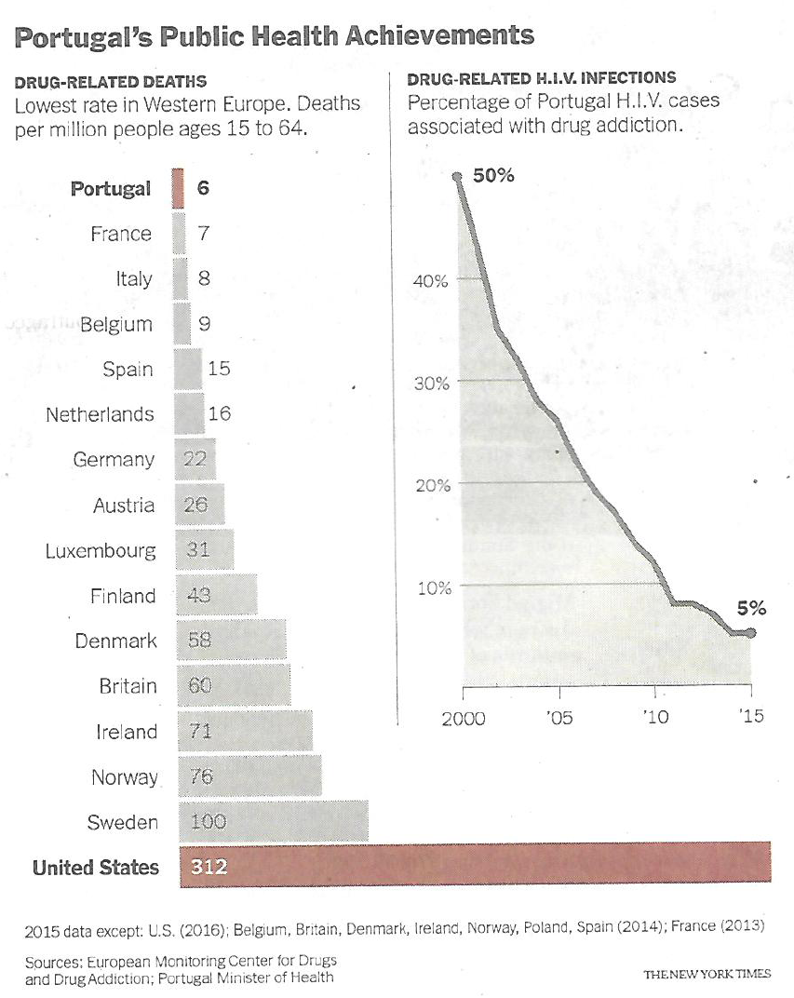
WORLD-WIDE
DRUG RELATED
DEATHS
PORTUGAL
DRUG RELATED
HIV

Slide 3
France
Increased OST reduces DRD
DRUG
RELATED
DEATHS
PATIENTS on
MAT
ARDS-2017 (March 17th-19^{th)} Baltimore
Martin Haraldsen, Norway
General practitioner (GP)

Slide 4
CRIME BEFORE AND DURING OST AT 6 PROGRAMS
(Ball and Ross, 1991)
Program:
Program:
Blue bars = crime-days per year when addicted.
Black bars = crime-days per year after 6 months or more in treatment. (N = 491)

Slide 5
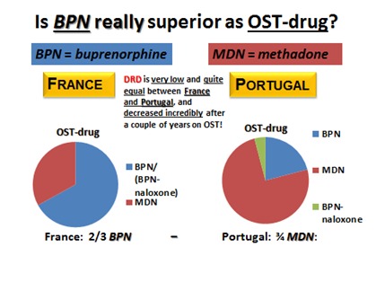

Slide 6
DISTRICT of COLUMBIA as EXEMPLAR
of
UNITED STATES HISTORY of PUNITIVE CARE using
MASS INCARCERATION as TREATMENT

Slide 7
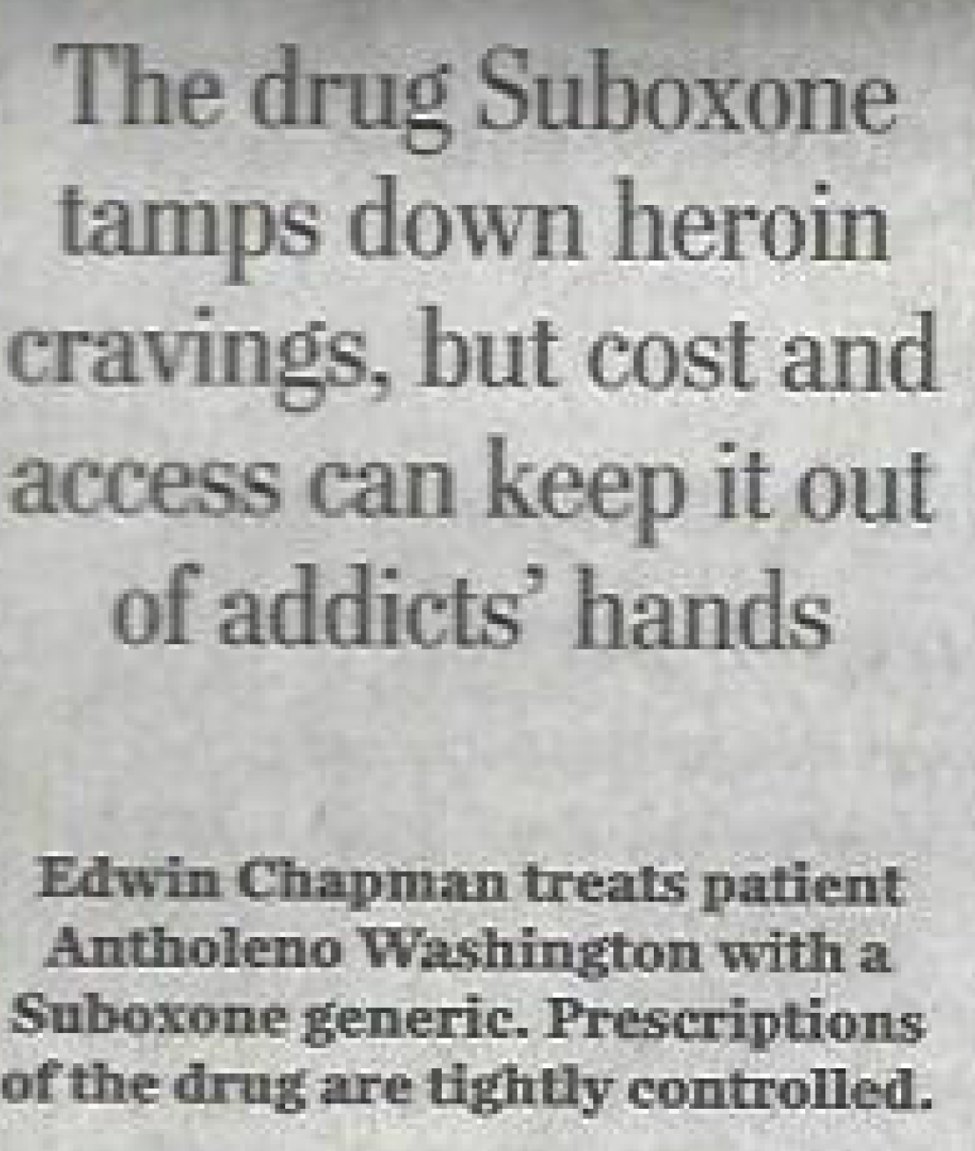
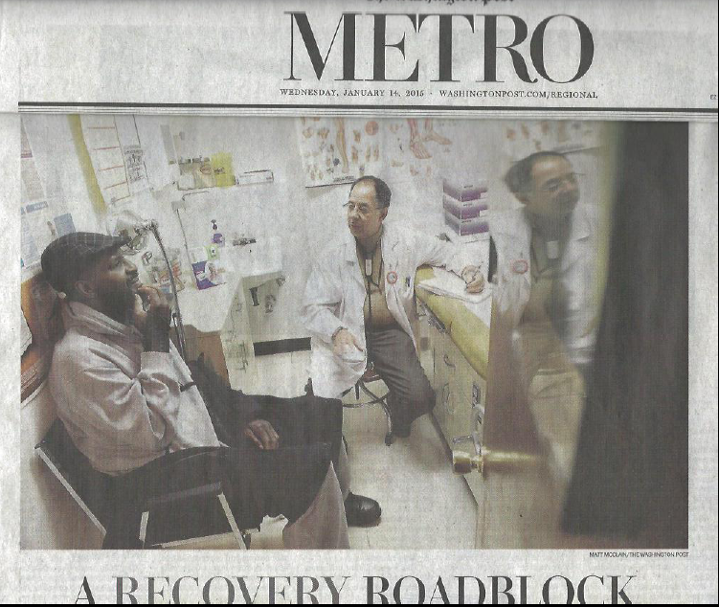
CHAPMAN, MD, PC
275 Current Patients on Buprenorphine:

Slide 8
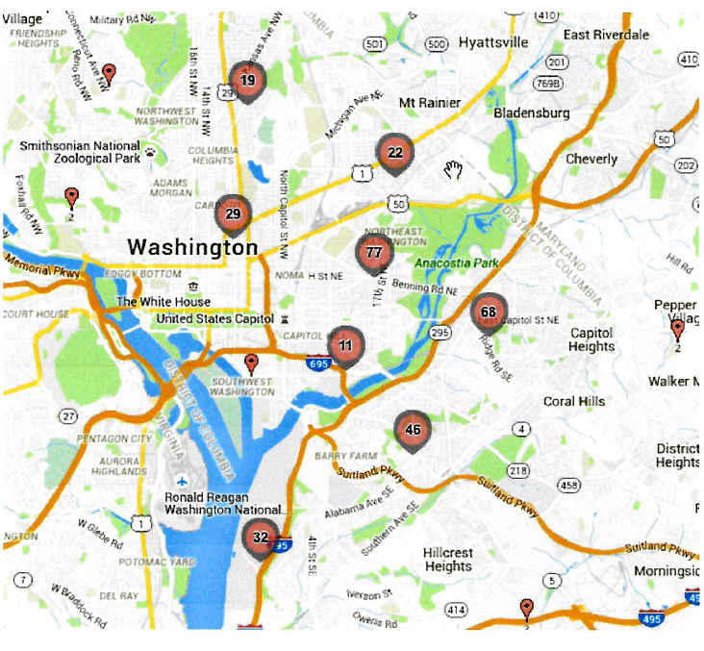
CHAPMAN, MD, PC BUPRENORPHINE PATIENT DISTRIBUTION
HEROIN in DC
CHAPMAN, MD, PC
EAST
END

Slide 9
(1) Average Age - 52yrs
(2) 2/3 Male vs. Female
(3) Average years incarcerated - 10
(4) > 50% require mental health medication
(5) 10 - 12% HIV+
(6) 60 - 65% Hepatitis C+
(7) 90% Smoke
(8) 25-50% Homeless or Insecure Housing
LIFE EXPECTANCY CUT SHORT by 20-25 YEARS
CHAPMAN, MD, PC
275 Current Patients on Buprenorphine:
Edwin C. Chapman, MD
Assistant Professor
Dept. of Behavioral Health
Howard University College of Medicine ©2014

Slide 10
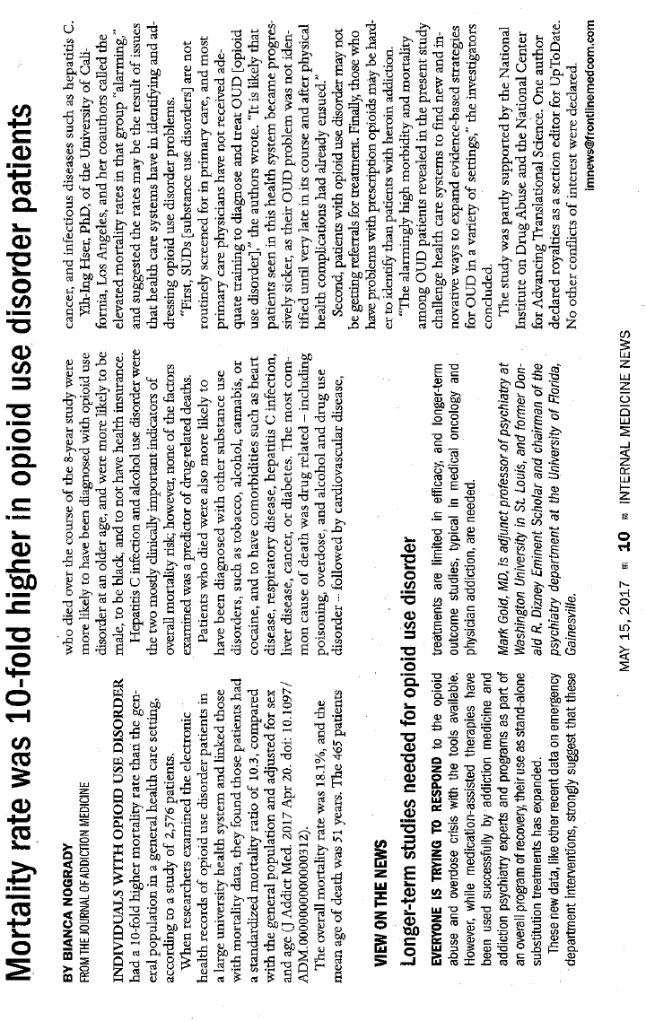
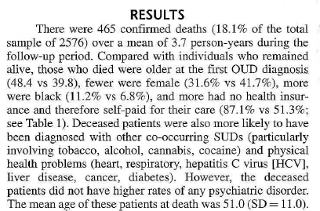

Slide 11
The OPIOID EPIDEMIC is
HIGH COST in
MONEY & LIVES

Slide 12
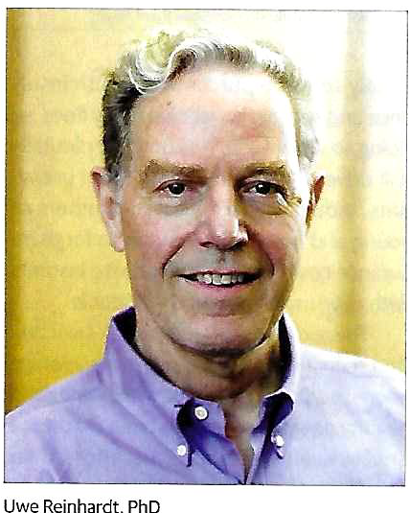

Slide 13
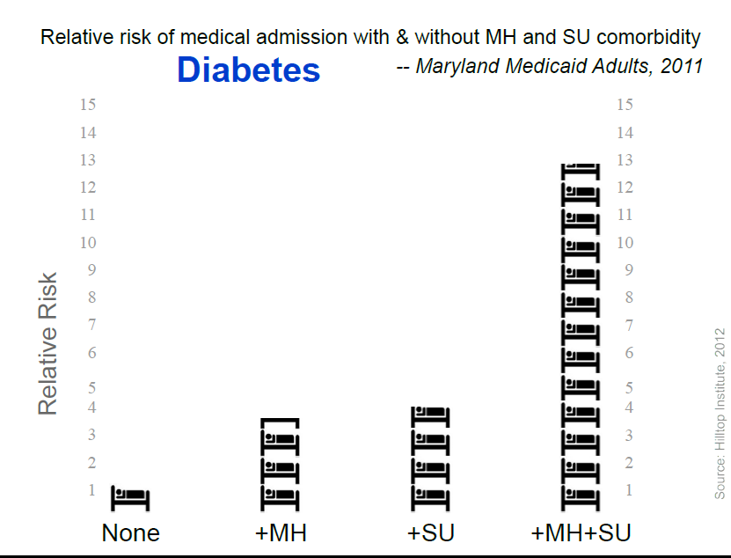

Slide 14
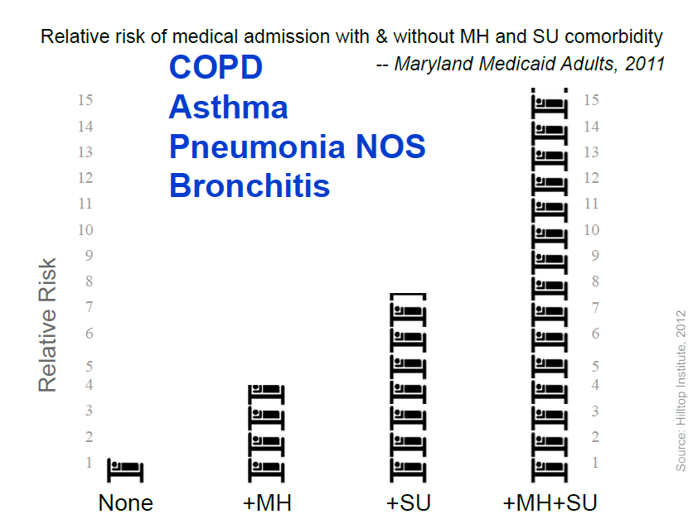

Slide 15
TOTAL IMPACT of an INDIVIDUAL PATIENT on COMMUNITY
UNTREATED PATIENT
PATIENT IN TREATMENT
INCREASED
JAIL &
CRIMINAL JUSTICE COSTS
INCREASED ED & HOSPITALIZATION HIV & HEP C COSTS
NORx
INCREASED COMMUNITY CRIME, UNEMPLOYMENT POOR SCHOOL PERFORMANCE, FAMILY DYSFUNCTION
DECREASED
JAIL &
CRIMINAL JUSTICE COSTS
DECREASED ED & HOSPITALIZATION HIV & HEP C
COSTS
INCREASED MAT
OPIOID
DRUG
Rx
DECREASED COMMUNITY CRIME, UNEMPLOYM’T, POOR SCHOOL PERFORMANCE, FAMILY DYSFUNCTION
TOTAL COST
COST SAVINGS
EDWIN C CHAPMAN, MD © 2017

Slide 16
TOTAL IMPACT of an INDIVIDUAL PATIENT on COMMUNITY
UNTREATED PATIENT
PATIENT IN TREATMENT
INCREASED
JAIL &
CRIMINAL JUSTICE COSTS
INCREASED ED & HOSPITALIZATION HIV & HEP C COSTS
INCREASED COMMUNITY CRIME, UNEMPLOYMENT POOR SCHOOL PERFORMANCE, FAMILY DYSFUNCTION
DECREASED
JAIL &
CRIMINAL JUSTICE COSTS
DECREASED ED & HOSPITALIZATION HIV & HEP C
COSTS
INCREASED MAT
OPIOID
DRUG
Rx
DECREASED COMMUNITY CRIME, UNEMPLOYM’T, POOR SCHOOL PERFORMANCE, FAMILY DYSFUNCTION
$35K
Criminal Costs
SILOED COSTS
Every $1 Spent on Treatment Saves $7
$15K
for
Rx
TOTALCOST
$105K
$35K
COST SAVINGS
Medical Costs
Social Costs
EDWIN C CHAPMAN, MD © 2017

Slide 17

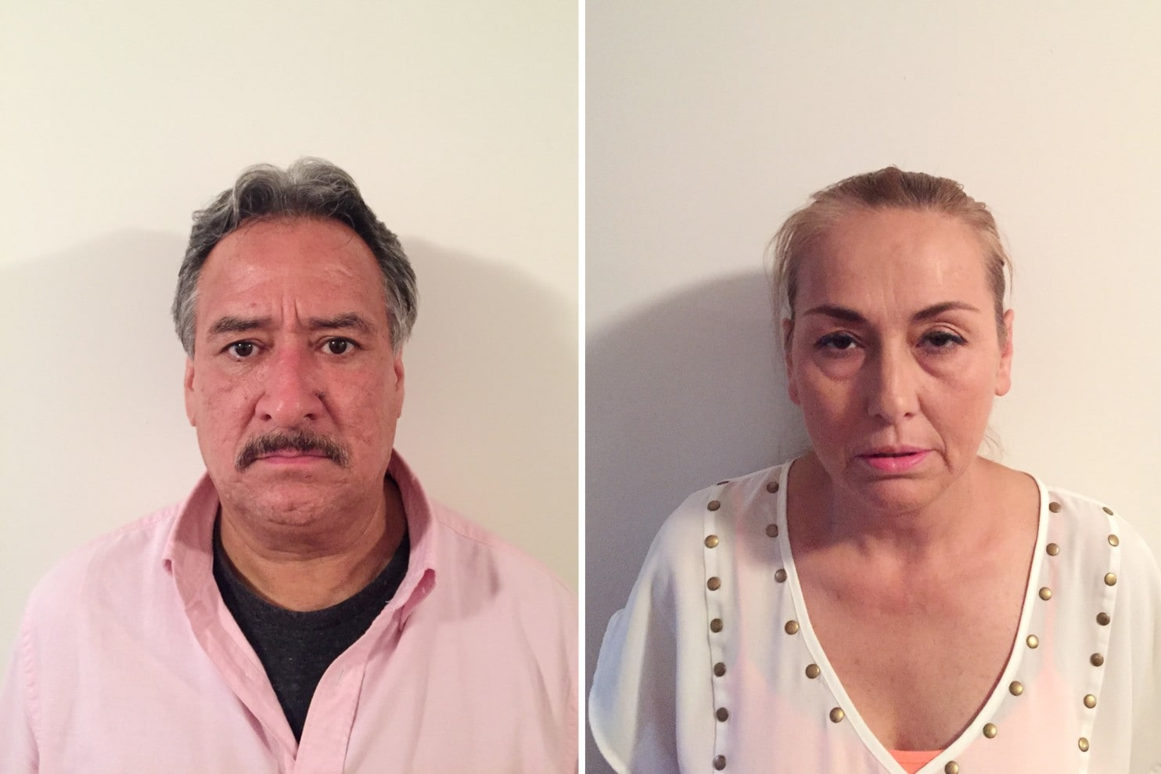
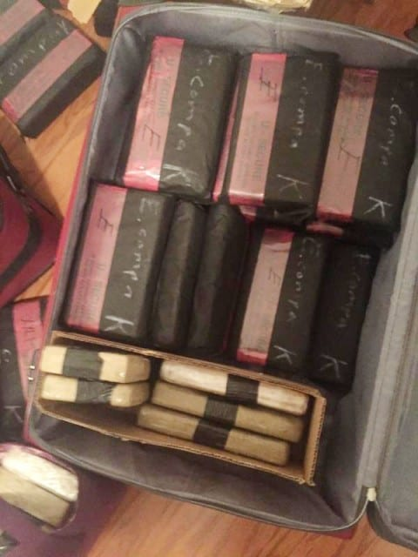
The UGLY!!
Mexican Traffickers Making New York a Lucrative Hub for Distribution of Fentanyl
By Nick Miroff By Nick Miroff National Security
November 13 at 5:58 PM
Alvarado-Robles and Flores-Solis had 141 pounds of pure fentanyl in their Queens apartment, enough to kill 32 million people, the Drug Enforcement Administration said. It was the largest seizure of the

Slide 18
WHAT WORKS and
WHAT DOSEN’T WORK?

Slide 19
OPIOID TREATMENT OPTIONS
1
Buprenorphine + Counseling
(best option)
2
Methadone + Counseling
(second best option)
3
Naltrexone + Counseling
(option three)
4
Counseling Only
(relatively poor outcomes)
5
Residential Treatment
(high cost + high relapse rate)
6
Incarceration as Treatment
(not medically acceptable)
Edwin C. Chapman, MD
©2016

Slide 20
OPIOID
PRE-TREATMENT
OPIOID TREATMENT OPTIONS
NEEDLE EXCHANGE
SAFE INJECTION
SITES
NARCAN
2nd CHANCE
NOT TREATMENT
ABSTINENCE ONLY
MAT
Necessitates
Decriminalization
of Non-Violent Drug Possession and Usage
NO Rx with
High Rates HIV, Hep C, Mental Illness
50%
Reduction in Deaths
Reduces Spread of HIV, Hepatitis C, & Other Infectious Diseases
Reduces ODs Spread of HIV, Hepatitis C, & Other Infectious Diseases
VERY HIGH RELAPSE
& DEATH RATE
Decrease HIV, Hepatitis C,
Improves Medical Compliance
Edwin C. Chapman, MD
©2017

Slide 21
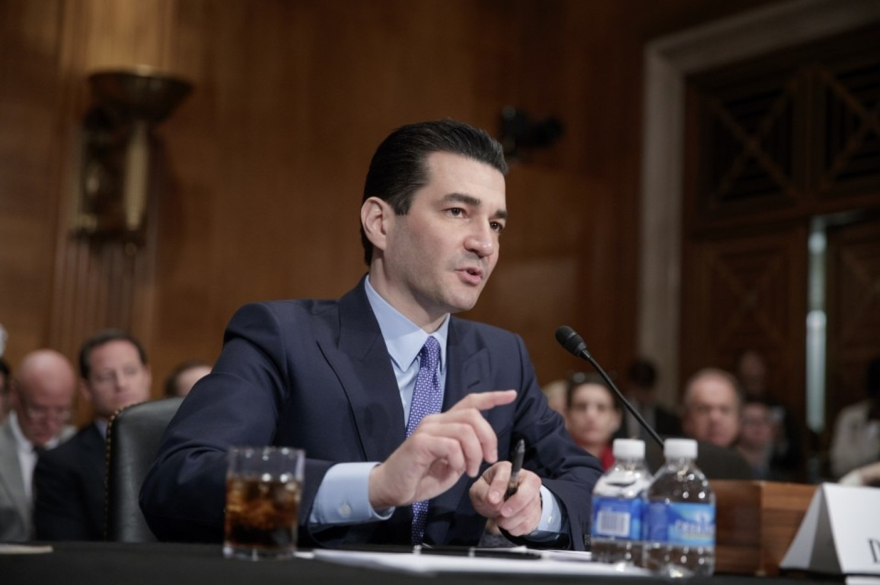
The GOOD NEWS !!
By Laurie McGinley By Laurie McGinley
To Your Health
Washington Post October 25, 2017
Scott Gottlieb, head of the Food and Drug Administration, testifies at his Senate confirmation hearing in April. On Wednesday, he told a House panel that the agency would promote the use of medication-assisted treatment for opioid use disorder. (J. Scott Applewhite/AP)

Slide 22
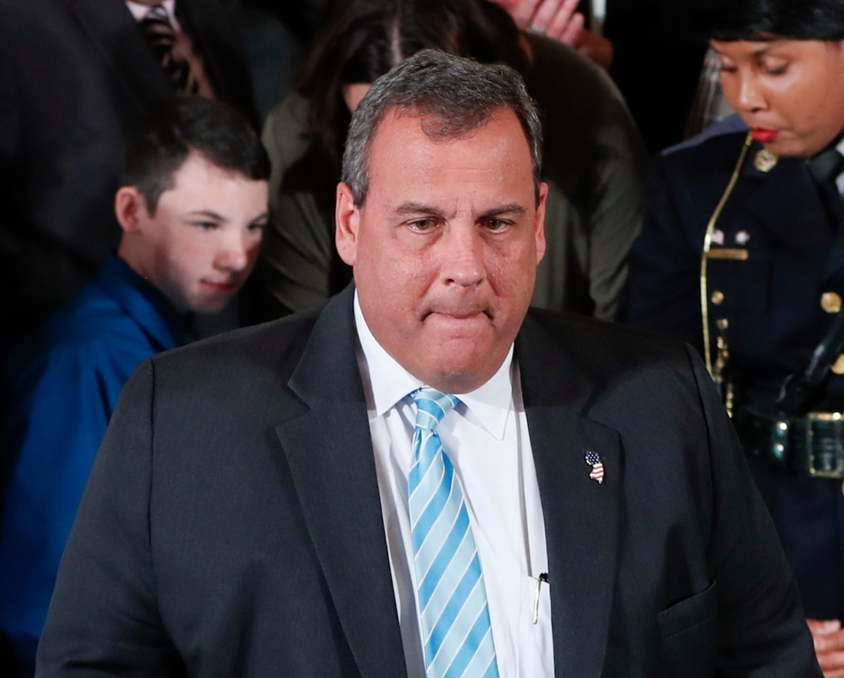
MORE GOOD NEWS !!
By Carla K. Johnson | AP
Business
November 1, 2017
President Donald Trump’s commission on the opioid crisis called Wednesday for more drug courts, more training for doctors and penalties for insurers that dodge covering addiction treatment.

Slide 23
FOUR PHILOSOPHICAL KEYS to TREATMENT:
“Harm Reduction” – Clinical Treatment Modality
“Contingency Management” – Clinical Tool
“Loss Mitigation” – Financial Efficacy of Rx
4. “Retention in Treatment” – Outcomes Measure

Slide 24
“HARM REDUCTION” & “LOSS MITIGATION”
thru
“CONTIGENCY MANAGEMENT” TREATMENT MODEL
DRUG USE
$105K
Facilitates Preventive &
Primary Care
Highest Risk, Highest Cost
(No Treatment)
$50K
$15K
Moderate Risk with
“Loss Mitigation”
(In Treatment, Labile)
NO DRUG USE
Low Risk, Lowest Cost
(Compliant In Treatment)
Contingency
Management

Slide 25
RETENTION in CARE !!
“RETENTION in CARE”
Is the ultimate quality of care measure….
One cannot treat those that you cannot reach
or
once touched… keep engaged in care!!
DRUG USE
$105K
Facilitates Preventive &
Primary Care
Highest Risk, Highest Cost
(No Treatment)
$50K
$15K
Moderate Risk with
“Loss Mitigation”
(In Treatment, Labile)
NO DRUG USE
Low Risk, Lowest Cost
(Compliant In Treatment)
Contingency
Management

Slide 26

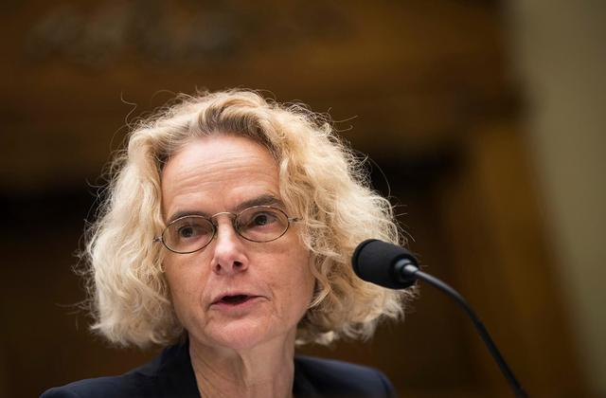
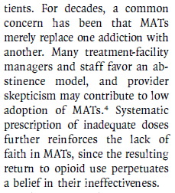
MORE GOOD NEWS !!

Slide 27
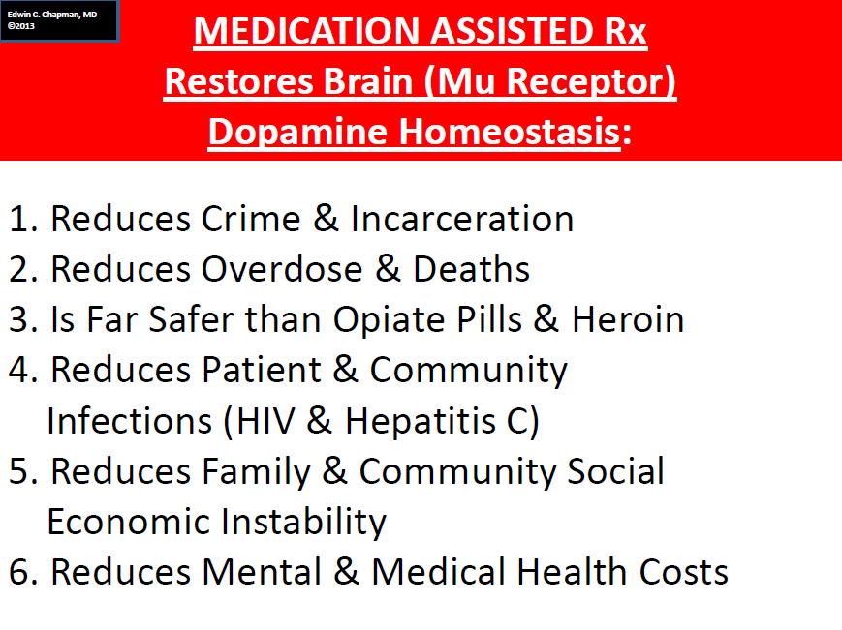
THEORETICAL IMPACT of MAT (Buprenorphine or Methadone)
LONG-TERM MAINTENANCE on HIV & HEPATITIS C TREATMENT S & COMPREHENSIVE CARE OUTCOMES
INDUCTION & STABILIZATION
RETENTION in TREATMENT
30-45 DAYS
INFINITY
BUPRENORPHINE & METHADONE MAINTENANCE
PSYC
PCP
SUD
15-20%
DROP-OUTS
TIME
Edwin C. Chapman, MD
©2013

Slide 28
MHDG OUTCOMES:
BUPRENORPHINE Rx RETENTION RATE
RETENTION RATE OVER TIME
Edwin C. Chapman, MD ©2017

Slide 29
HOWARD UNIVERSITY & MHDG
introduce the
PORTUGESE & FRENCH
OPIOID TREATMENT MODEL
to
WASHINGTON, DC

Slide 30
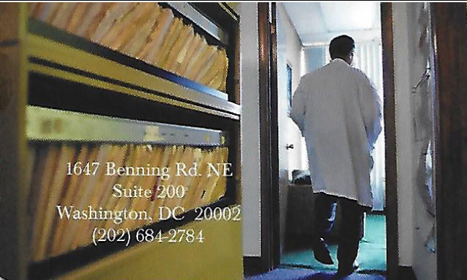

Slide 31
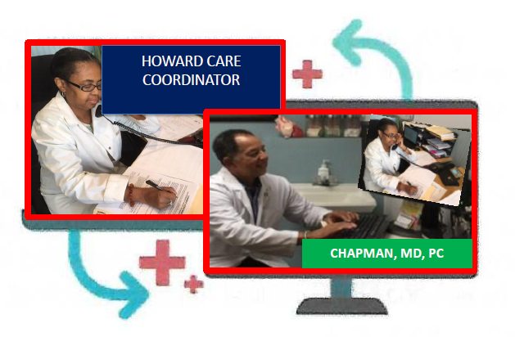
Telemedicine is a two-way, real-time interactive
video-audio communication for the purpose of evaluation, diagnosis, consultation, or treatment

Slide 32


NW
Geographically Distributed Medical Practices”
NE
HOWARD UNIVERSITY “URBAN HEALTH INITIATIVE” TELE-MEDICINE VIRTUAL
PATIENT-CENTERED BEHAVIORAL HEALTH HOME NETWORK:
For MAT of OPIOID DEPENDENT PATIENTS & FAMILIES
HOWARD
UNIVERSITY
HOSPITAL
MHDG SITE #2
MHDG SITE #1
CHAPMAN, PC
SERVICES
PRIMARY CARE
PSYCHIATRY
SUD
Geographically Distributed Medical Practices
Geographically Distributed Medical Practices
SOCIAL
WORKER
INFECTIOUS
DISEASE
COMMUNITY NAVIGATORS
SW
SE
Edwin C. Chapman, MD, PC ©2015
Geographically Distributed Medical Practices

Slide 33



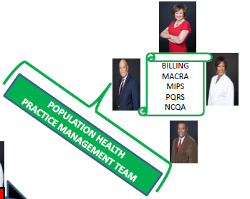





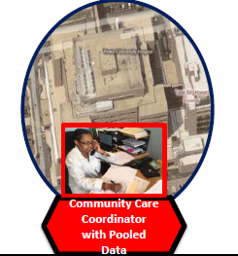



Tele-Medicine Augmented Care Coordination
PHARMACO-
GENOMIC
“PRECISION CARE”
VIRTUAL PRACTICE MANAGEMENT
CLOUD BASED
VIRTUAL CARE
WHEREEVER YOU ARE!!
OUR TARGET PATIENT
OFFICE
BASED
DIRECT PATIENT
CARE
SITE #3
NP
SITE #2
DATA
COLLECTION
MD
PSY
DC
OPIOID
TREATMENT
SYSTEM
(DOTS)
PRECISION
MEDICINE
MHDG
VIRTUAL & ONSITE
PRIMARY CARE
SUPPORT
to
ALL 3 DC
METHADONE CLINICS
SITE #1
MD
SITE #4
MD
SW
SITE #5
MD
INTERDISCIPLINARY, VIRTUAL,
MULTISITE PRACTICE
Edwin C. Chapman, MD
MHDG ©2017

Slide 34
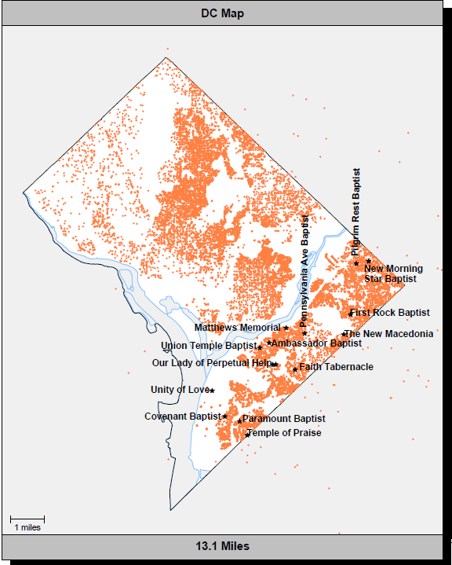
EAST
END
MENTOR
MENTEE
MENTEE
MENTEE
MENTEE
WARD 4
MEDICAID PATIENTS
WARD 5
WARD 7
WARD 8
WINGATE

Slide 35

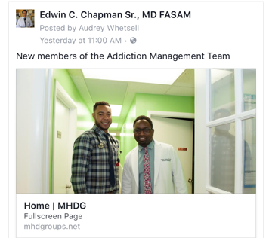

Slide 36
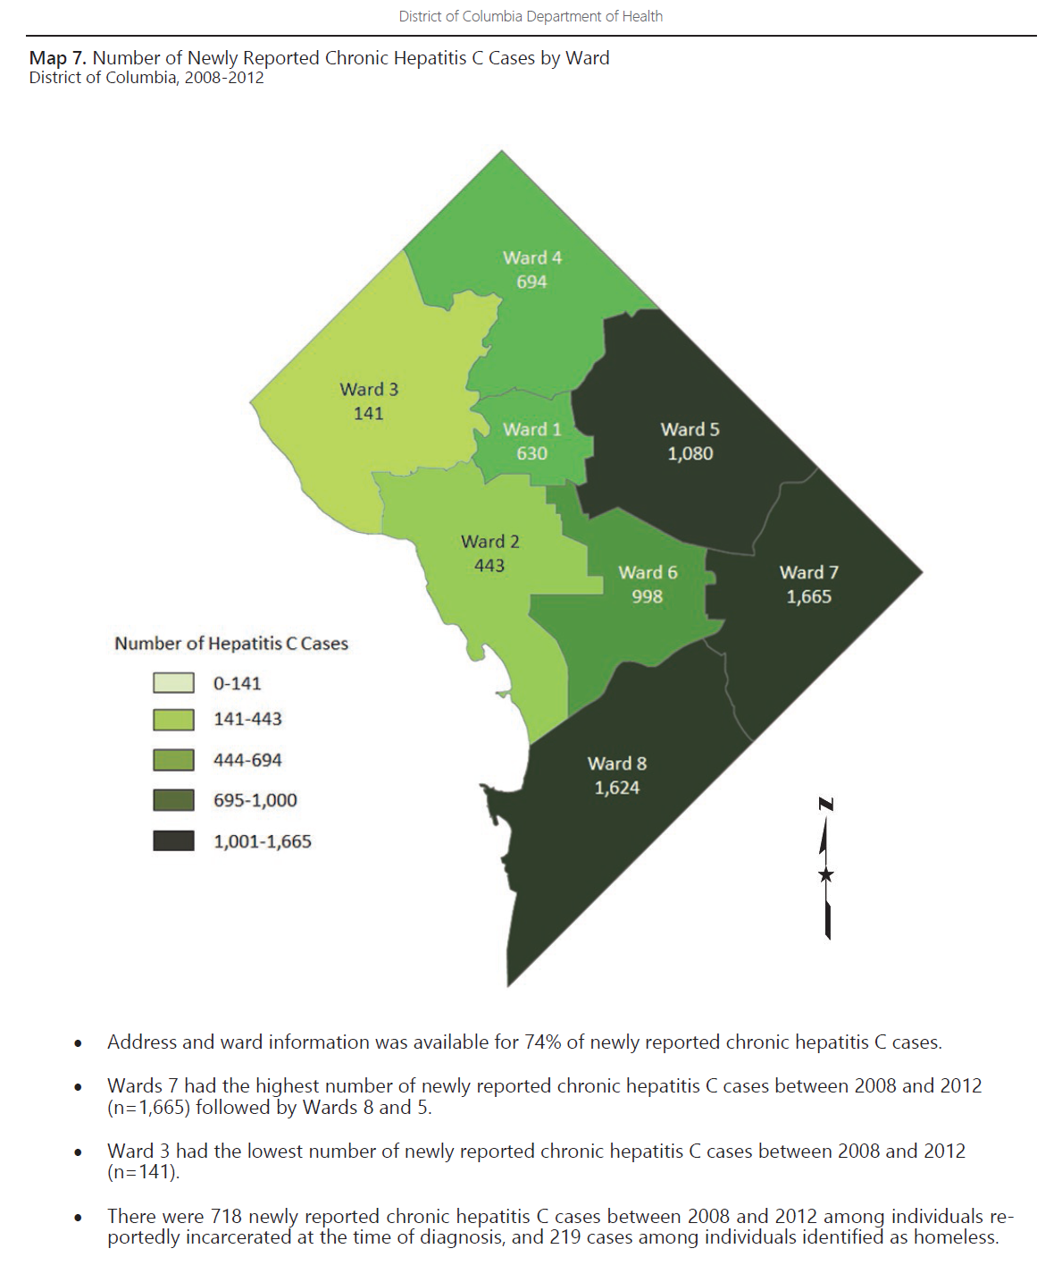
NW
Geographically Distributed Medical Practices”
NE
TELEVIDEO MEDICINE
1st Baptist Church
Health Ministry
HUH
Homeless Shelter
CHAPMAN, PC
Geographically Distributed Medical Practices
Geographically Distributed Medical Practices
VIRTUAL HEALTH CARE using
and
CLOUD BASED MEDICAL RECORDS for
“PRECISION TREATMENT”
School Based Health Center
TELEVIDEO MEDICINE
UMC
MARYLAND
WINGATE
SW
SE
Geographically Distributed Medical Practices

Slide 38
“The secret to quality is
…!”
Professor Avedis Donabedian,
University of Michigan School of Public Health
LOVE
Edwin C. Chapman, MD
©2016

Slide 39

TEAM
WORK

Slide 40
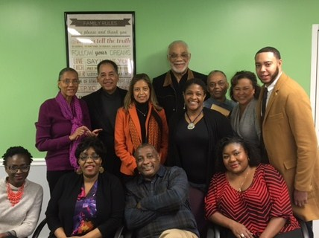

Slide 41

“SCIENCE TO SERVICE”
Health Outreach To Promote Community Engagement!
“SCIENCE TO SERVICE”
QUESTIONS?

